Slide 1
Project
Web scrapping : Amazon Reviews
By : N.Thoulath

Slide 2
IMPORT LIBRARY AND USAGE
# Import re
re (Regular Expressions):
The re module provides support for regular expressions, which are used to match and manipulate text based on patterns.

Slide 3
IMPORT LIBRARY AND USAGE
# Import requests
# import request
requests:
The requests library allows you to send HTTP requests to web servers and retrieve data from websites

Slide 4
IMPORT LIBRARY AND USAGE
# Import matplotlib.Pyplot as plt
matplotlib.pyplot:
The matplotlib.pyplot module is a part of the Matplotlib library, which is used for creating data visualizations, such as plots and charts

Slide 5
IMPORT LIBRARY AND USAGE
#From bs4 import beautifulsoup
BeautifulSoup (from 'bs4'):
BeautifulSoup is a library for web scraping that allows you to parse and extract information from HTML and XML documents. It's often used to extract data from web pages.

Slide 6
IMPORT LIBRARY AND USAGE
# From wordcloud import wordcloud, STOPWORDS
WordCloud:
The WordCloud library is used to create word clouds, which are visual representations of text data where the size of each word in the cloud is proportional to its frequency in the text.
STOPWORDS:
The STOPWORDS variable likely contains a set of common words that are often excluded from word clouds and text analysis because they don't carry significant meaning (e.g., "the," "and," "in," etc.).

Slide 7
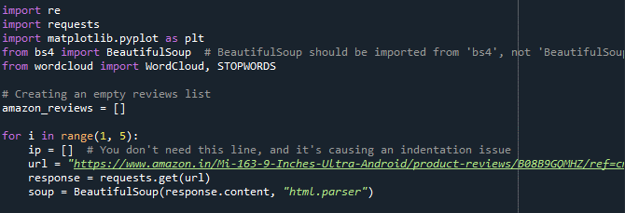
Program Code

Slide 8
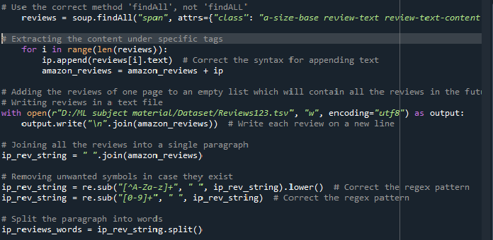
Program Code

Slide 9
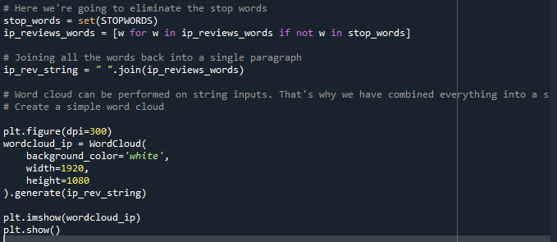
Program Code

Slide 10
Explain with Step by Step
Creating an Empty List: An empty list amazon_reviews is created to store the scraped reviews.
For Loop: A for loop iterates from 1 to 4. This controls how many pages of reviews you want to scrape from Amazon.
URL: The url variable contains the URL of the Amazon product's review page. You should replace this URL with the actual product's URL from which you want to scrape reviews.

Slide 11
Explain with Step by Step
4.HTTP Request: requests.get(url) sends an HTTP GET request to the specified URL, and the response is stored in the response variable.
5.HTML Parsing: BeautifulSoup is used to parse the HTML content of the response, and the parsed content is stored in the soup variable.
6.Scraping Reviews: soup.findAll("span", attrs={"class": "a-size-base review-text review-text-content"}) is used to find and extract the review text from the HTML. It searches for all span elements with the specified class, which typically contains the review text. The extracted reviews are appended to the ip list.

Slide 12
Explain with Step by Step
7.Appending Reviews to List: The scraped reviews are appended to the amazon_reviews list for each iteration of the loop. The previous code attempted to join the ip list with the amazon_reviews list, but it should be done outside the loop to aggregate all reviews correctly.
8.Writing Reviews to a Text File: The code writes the scraped reviews to a text file named "Reviews23.tsv" in the "D:/ML subject material/Dataset/" directory. Each review is written on a new line in the file.

Slide 13
Explain with Step by Step
9.Text Processing:
The code joins all the reviews into a single string ip_rev_string.
It removes unwanted symbols and non-alphabetic characters using regular expressions.
It also removes numbers from the text.

Slide 14
Explain with Step by Step
10.Text Splitting and Stop Words Removal:
The paragraph is split into words.
A set of stop words (common words like "and," "the," "is," etc.) is defined using STOPWORDS.
It removes stop words from the list of words.

Slide 15
Explain with Step by Step
Creating a Word Cloud:
The code uses the word cloud library to create a word cloud visualization.
It specifies parameters for the word cloud, such as the background color, width, and height.
The WordCloud object generates a word cloud from the processed text.
The word cloud is displayed using Matplotlib.

Slide 16
.
Thank You…

